Slide 1


Project name: Multi-Axis Cobot For Factory Automation
Team members: Adrian Guzman, Emily Hamsa, Ethan Woods, Jaishil Shah
Notes:
Ethan

Slide 2

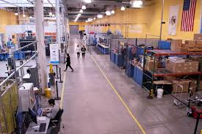
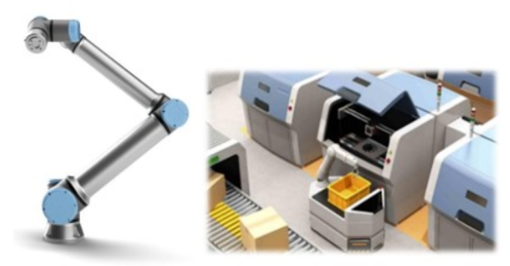
Project Description
Problem statement:
Factory settings pose dangerous environments to human workers through the exposure to heavy machinery, tight spaces, and repetitive workloads. These hazards increase chance of injury and worker burnout. We need to implement collaborative robots (Cobots) to improve worker conditions.
Human Injury & Burnout in Warehouses
Cobot Solution
Notes:
Adrian

Slide 3
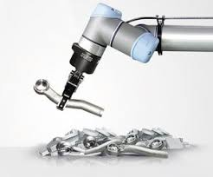
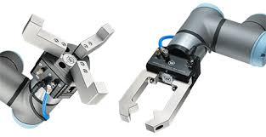
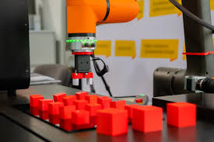
Project Description
Solution proposal:
Develop a Cobot that can integrate into a factory environment to reduce human injury, worker burnout, and increase productivity in repetitive tasks. The Cobot shall be able to lift (1-2lbs) and be placed into tight environments and controlled wirelessly through mobile app.
Precise Control
Repetitive Tasks
1-2 lbs. Load
Notes:
Ethan

Slide 4
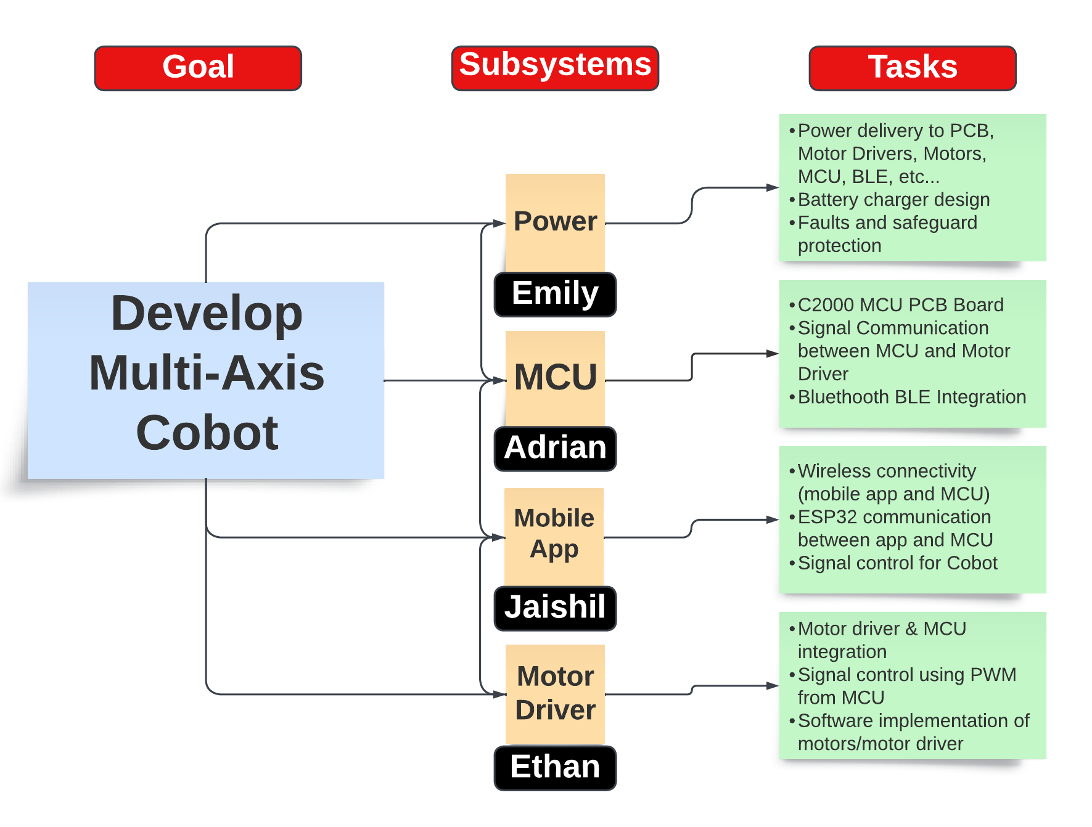
Subsystem Division
Subsystem Intro Projects:
i) Microcontroller
Adrian Guzman
ii) Electronic Circuits
Emily Hamsa
Ethan Woods
iii) Application Development
Jaishil Shah
Notes:
Emily

Slide 5
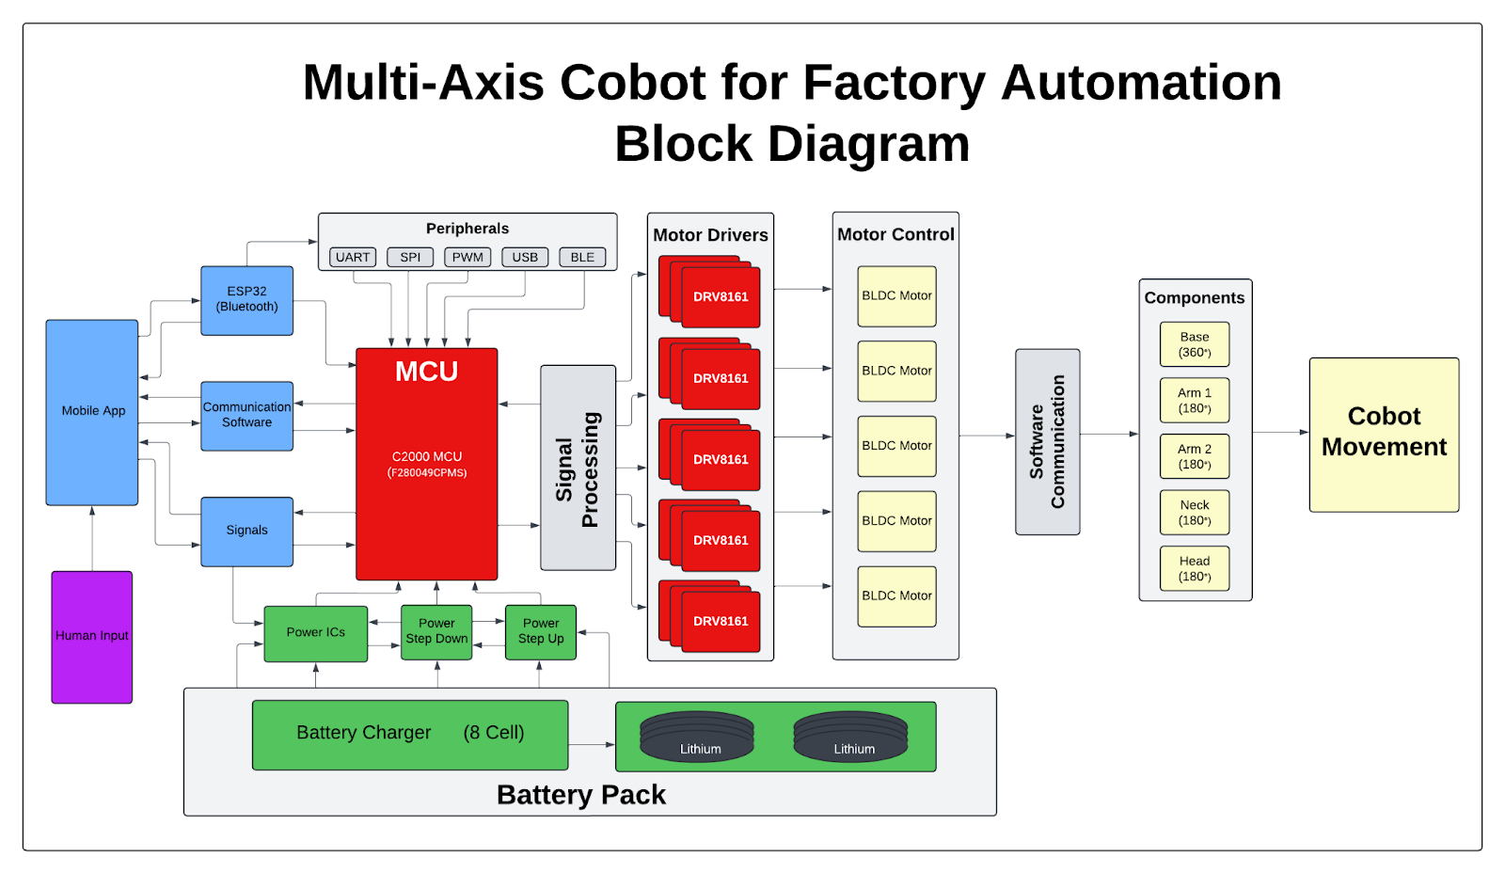
Diagram of subsystems and interface
Subsystem Diagram Color: Power, MCU/Connectivity, Mobile App, Motor Control
Notes:
Jaishil

Slide 6
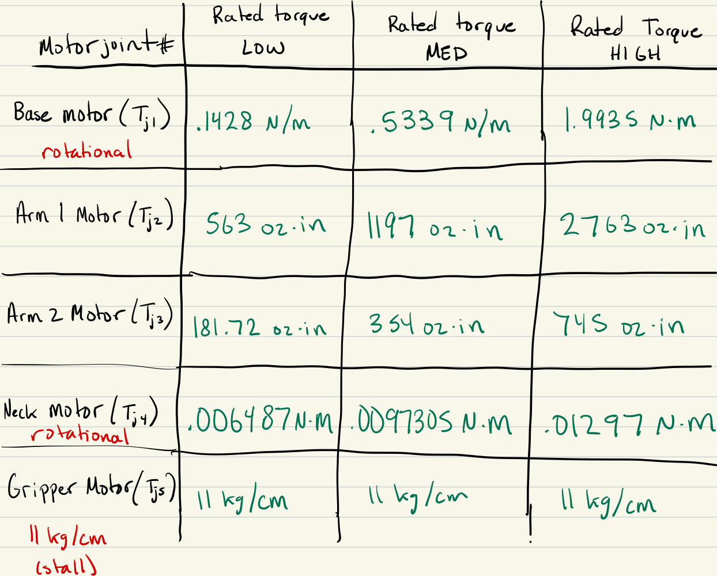
Motor/Motor Driver Subsystem
Ethan Woods
Accomplishments since the last presentation <18> hrs spent | Ongoing progress/problems and plans until the next presentation
Research and Create Possible Motor List Completed CONOPS, FSR, ICD Calculate Motor Torque Ranges for all Motors Subsystem Design Project Pick Motors based on Calculated Values | Figure out Budget for Motors Motors are EXPENSIVE Order a Motor and begin working with EVM Board Begin Learning and Understanding PWM signals for Motor Movement
List of Chosen Motors:
57BSA Series BLDC Motor
NEMA 34 Hudson Servo Motor !!!
NEMA 23 Hudson Servo Motor !!!
42BYA Series BLDC Motor
MG996R Servo Motor (gripper)
Total Estimated Cost: $668!!!
List of Calculated Torques for Motors #1 - #5

Slide 7
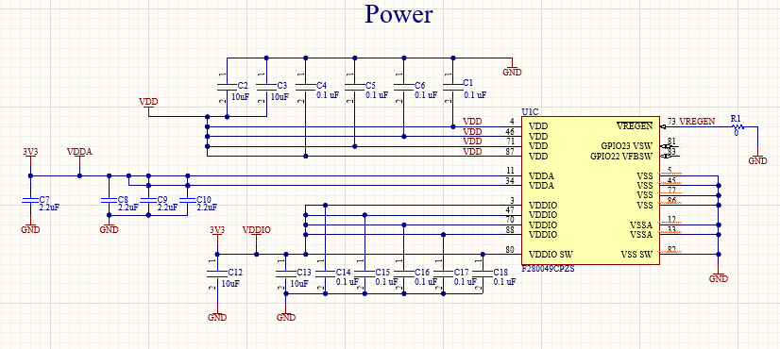
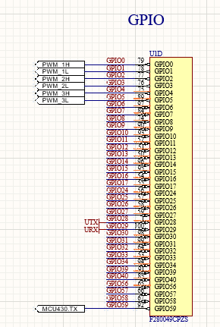
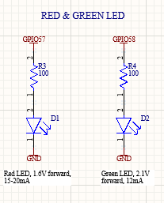
MCU/Processing
Adrian Guzman
Accomplishments since the last presentation <~30 hrs> | Ongoing progress/problems and plans until the next presentation
MCU Power MCU + ESP-32 Connectivity Motor Driver x3 Power Stage x3 Schematic order and neatness Datasheets & signals (find out what goes where) Intro Project / FSR, ICD, validation | Set GPIO and PCB headers for motor signals Review schematic and begin PCB layout Order PCB, components, and assemble C2000 Launchpad software development (write code to blink LED)

Slide 8
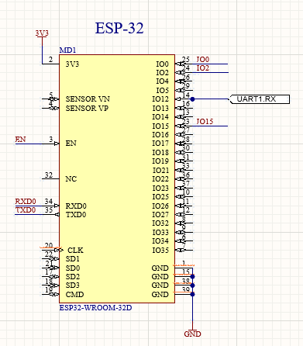
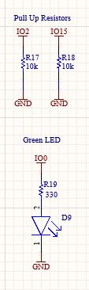
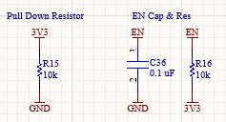
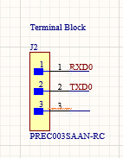

Slide 9
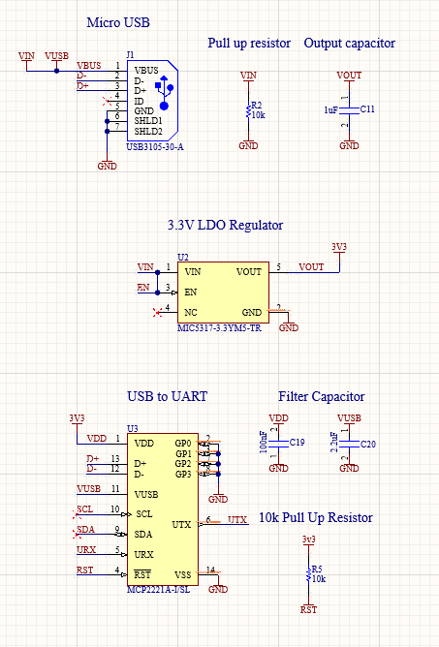

Slide 10
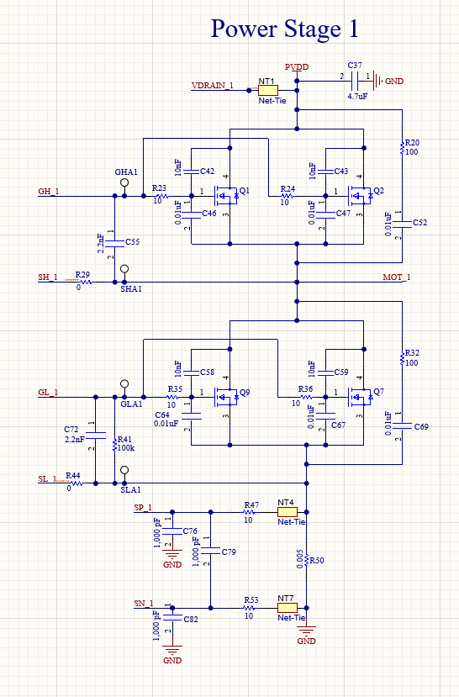
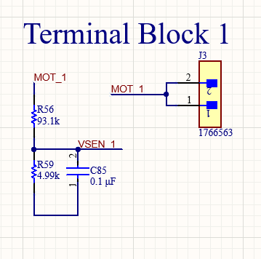
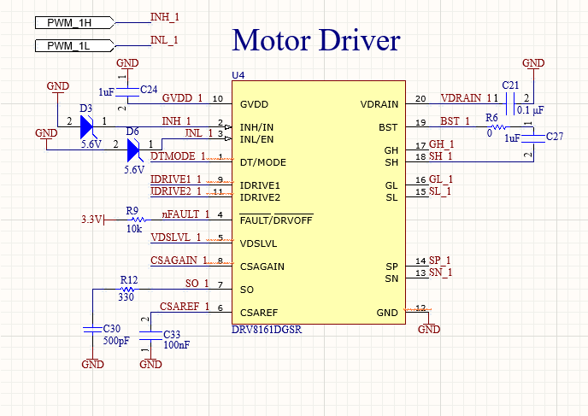
3x Instances of (power stage, terminal block, motor driver…1 for each phase)

Slide 11
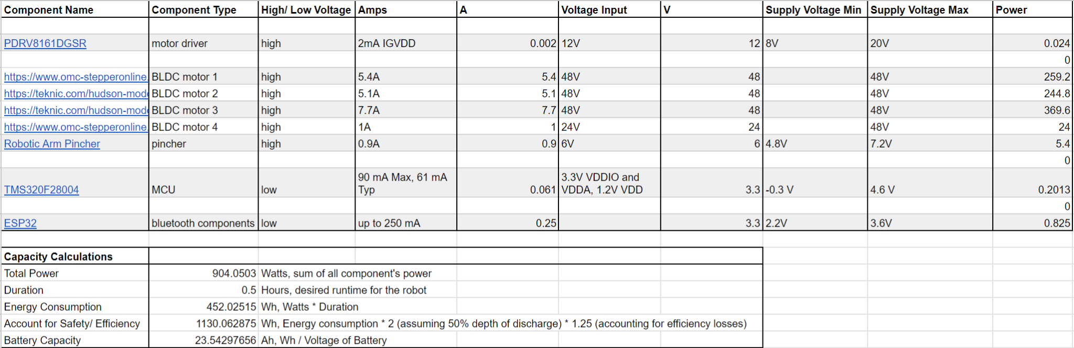
Power and Battery Management
Emily Hamsa
Accomplishments since the last presentation <~16> hrs | Ongoing progress/problems and plans until the next presentation
Researched battery capacity sizing Completed on CONOPS, FSR, ICD Subsystem Design Project Completed Load List and battery calculations Used TI WeBench to begin schematic design | Complete schematic designing and combine into one PCB Multiple rails with multiple current requirements, learn best way to connect Send board to be produced Choose a battery with calculated capacity Begin planning charging PCB

Slide 12
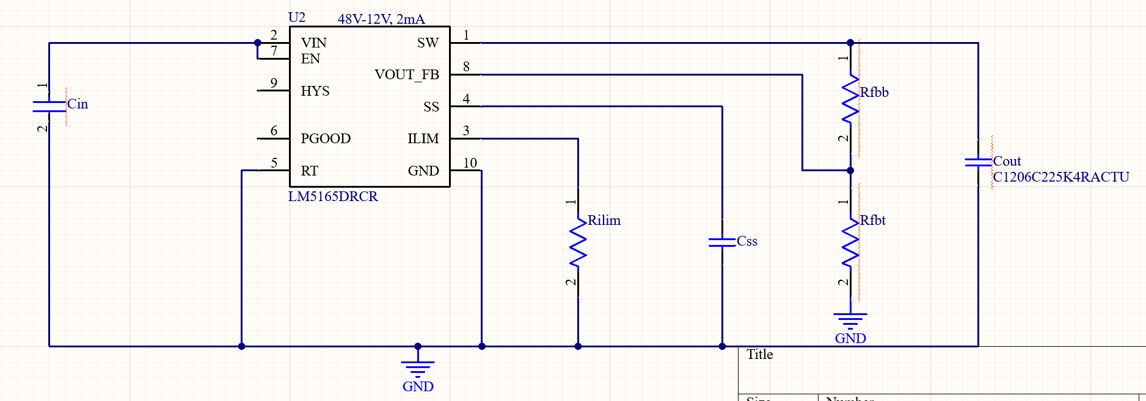
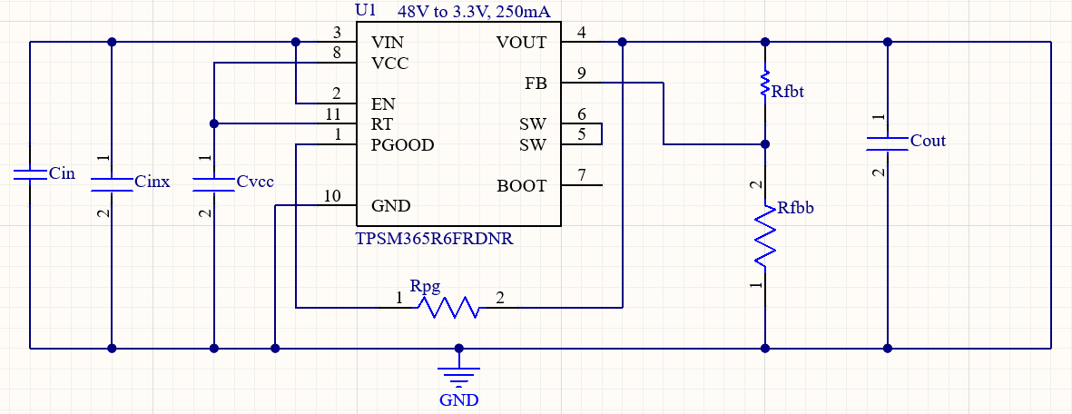

Slide 13
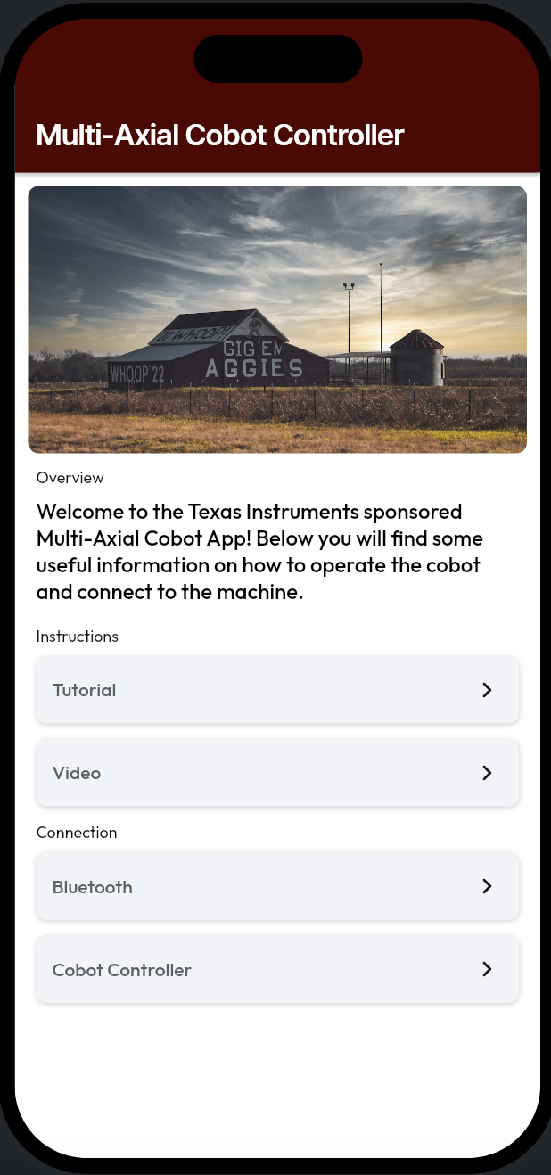
User Interface / Wireless Connectivity
Jaishil Shah
Accomplishments since the last presentation <~17 ½ > hrs | Ongoing progress/problems:
- Subsystem Intro. Project <3> hrs - Completion of the following documents: CONOPS, FSR, ICD <4> hrs - Subsystem Bluetooth integration <3> hrs - ESP-32 Connectivity (Arduino IDE) <3> hrs - App Store Connect Setup/Testflight <2> hrs - Flutterflow Beginner Course <2 ½ > hrs | 1. Fixing current bluetooth config. & ESP-32 setup 2. Secure ESP-32/Bluetooth connection with low latency 3. Breadboard -> PCB for ESP-32 4. Deployment of final application onto the App Store
List of Bluetooth Functions:
1. connectDevice 2. disconnectDevice
3. findDevices 4. getConnectedDevices
5. getRssi 6. isBluetoothEnabled
7. receiveData 8. sendData
Important Tools:
1. flutter_blue_plus 1.33.4
2. Bluetooth Low Energy
3. Arduino IDE 2.1.0

Slide 14
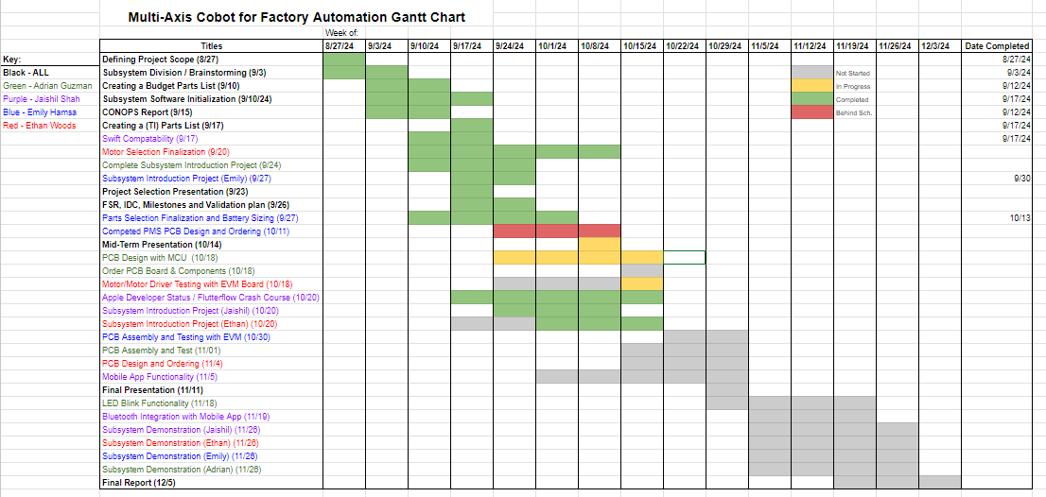
Execution plan

Slide 15
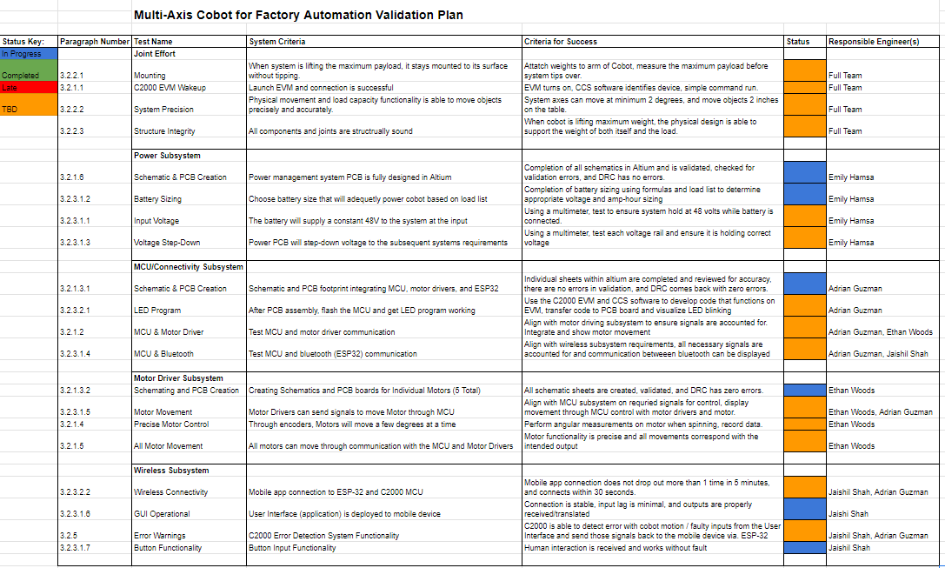
Validation plan
Notes:
Jaishil

